Slide 1
LWC Assignment Shopping Cart
In this assignment I tried to built a shopping cart site on LWC and implemented the invoice attachment as PDF which involves VF page too.

Slide 2
Demo Video Link
https://drive.google.com/file/d/1ficHXaIkn2DM4MP67DKBYjPN2416Oe8K/view?usp=drivesdk

Slide 3
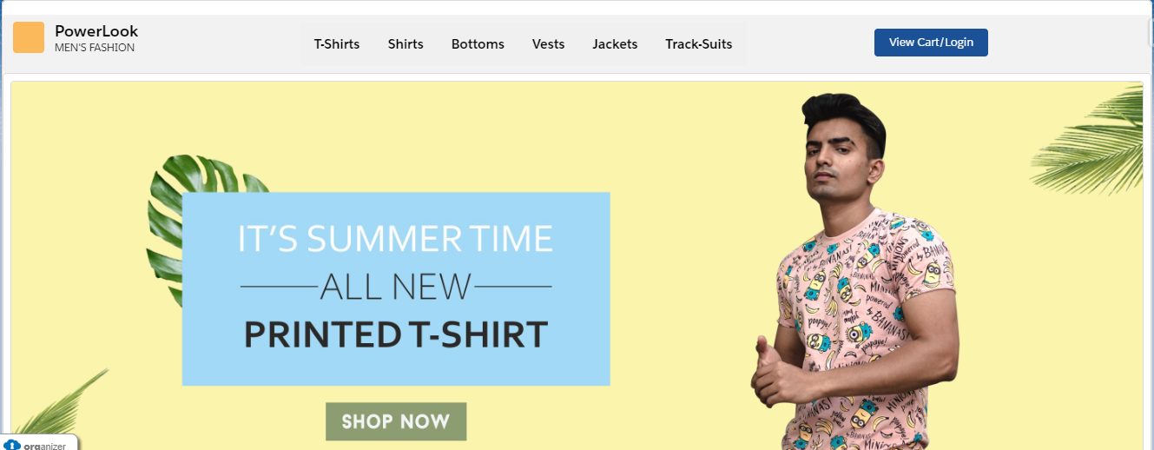
Main Page

Slide 4
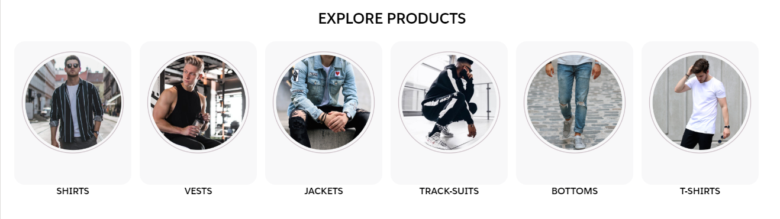
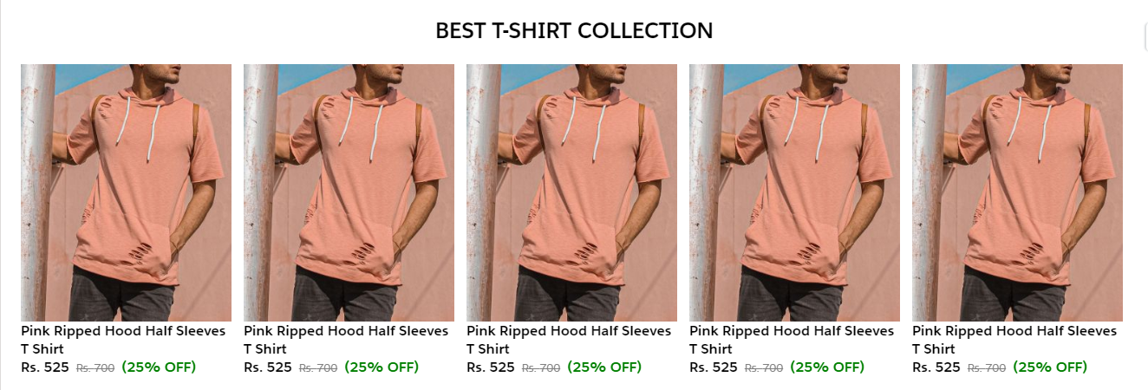

Slide 5
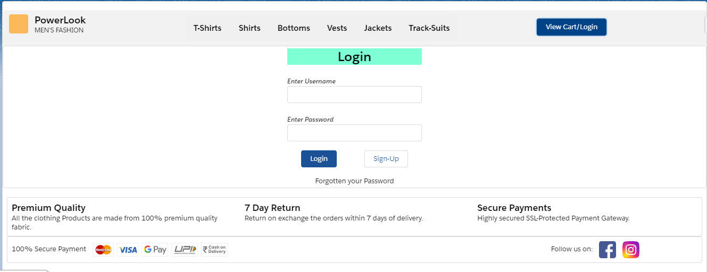
Login and Sign Up Page

Slide 6
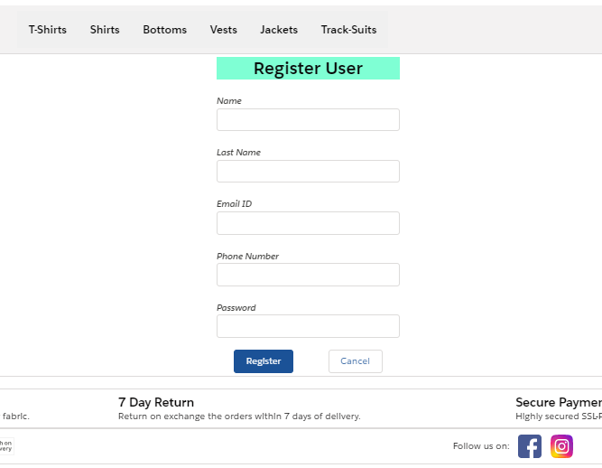

Slide 7
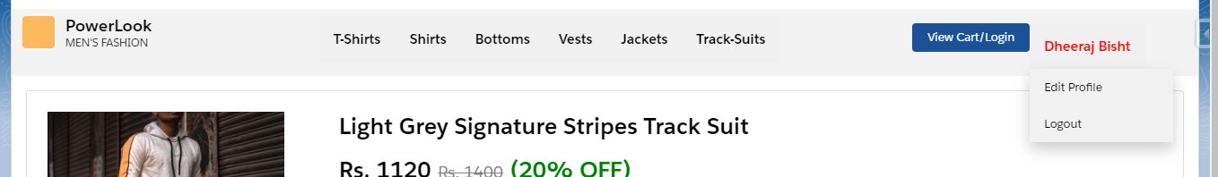
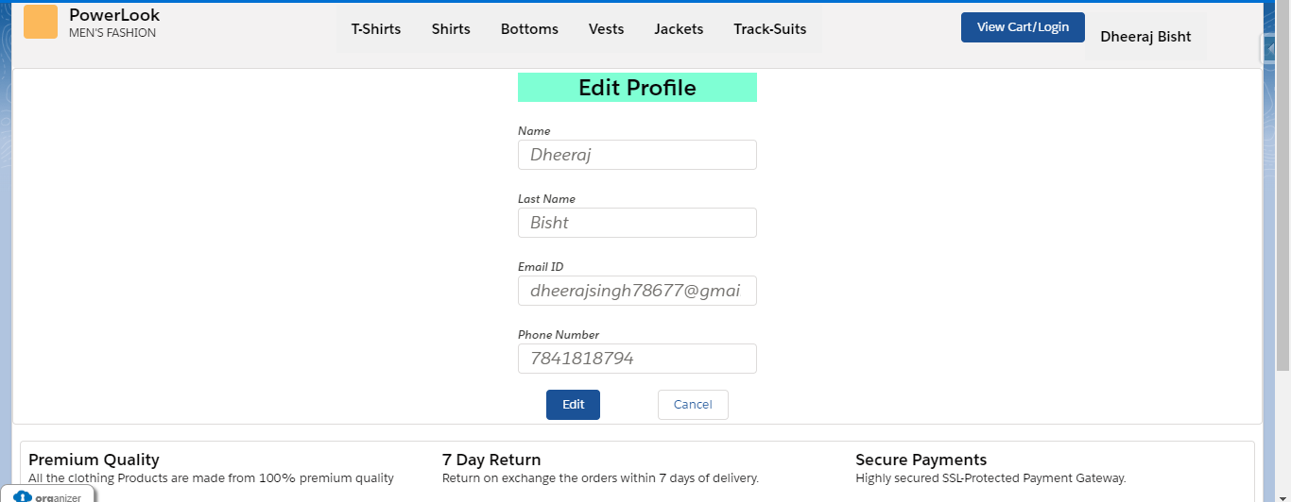
Edit Profile

Slide 8
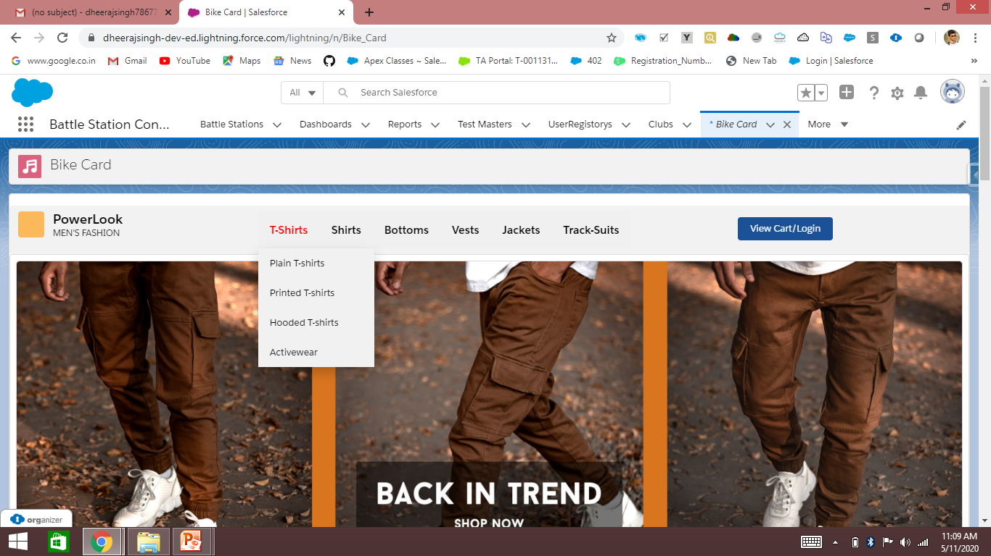
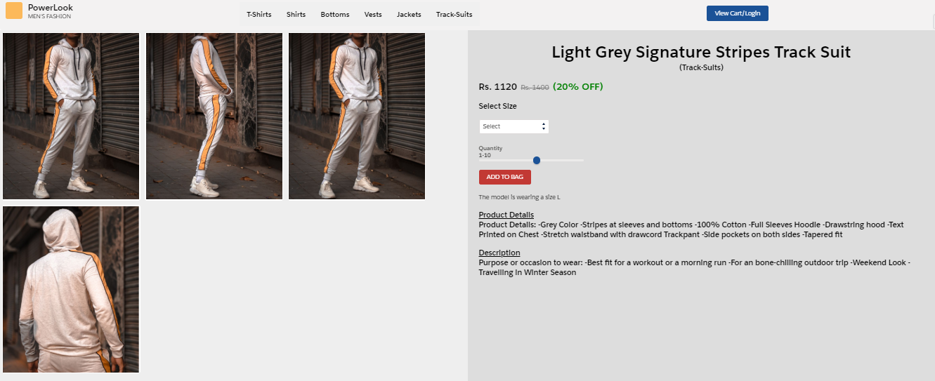
Product Page Layout

Slide 9
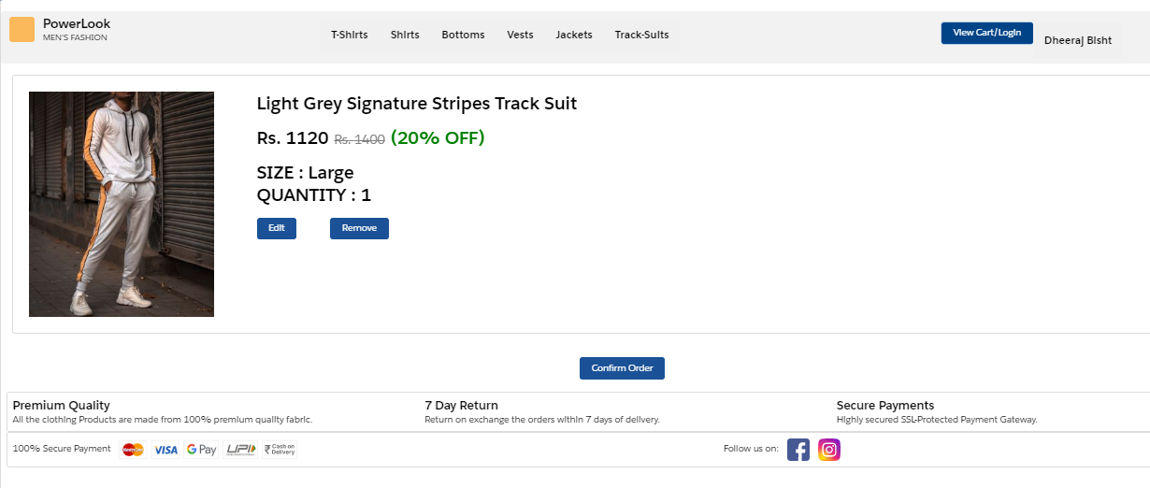
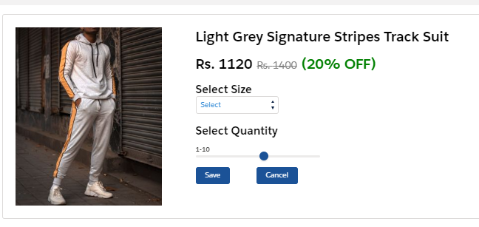
Cart Detail to add product you have to login
One can edit the size and quantity

Slide 10
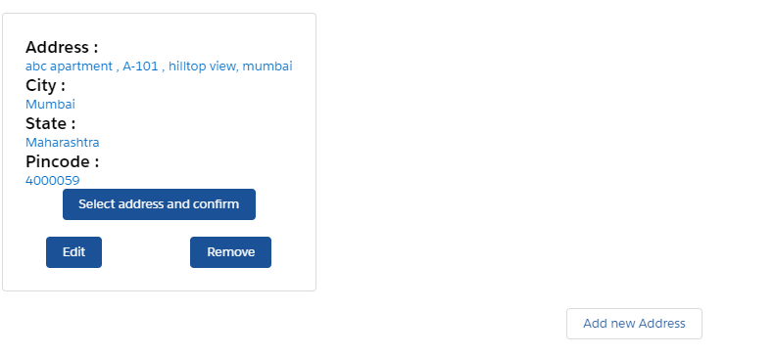
Confirm Order There is a button in cart page ‘Confirm Order’ which redirects you to Select/Add address page to confirm your deliver address.

Slide 11
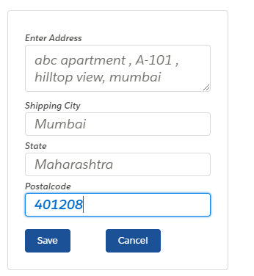
Edit your current address

Slide 12
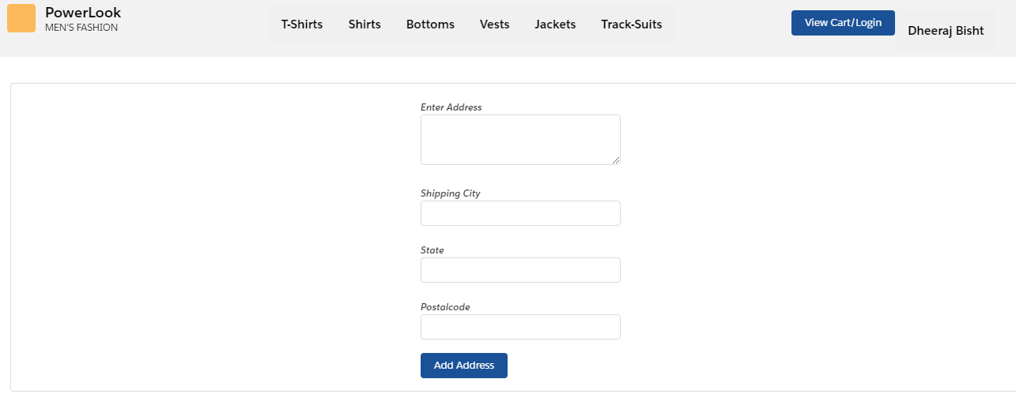
Add new address

Slide 13
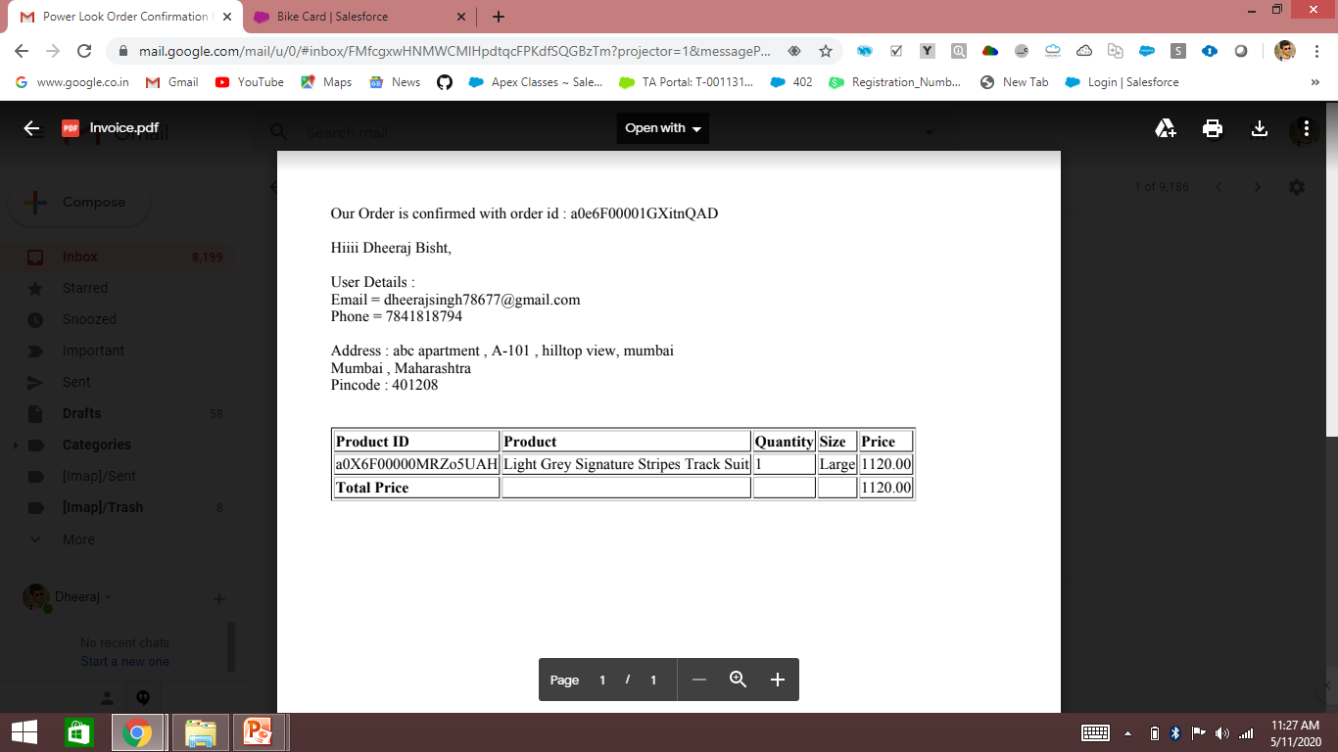
After selecting the address an invoice is generated
This invoice is mailed to customer and also saved in database under notes and attachment with respect that your order is confirmed.

